Slide 1
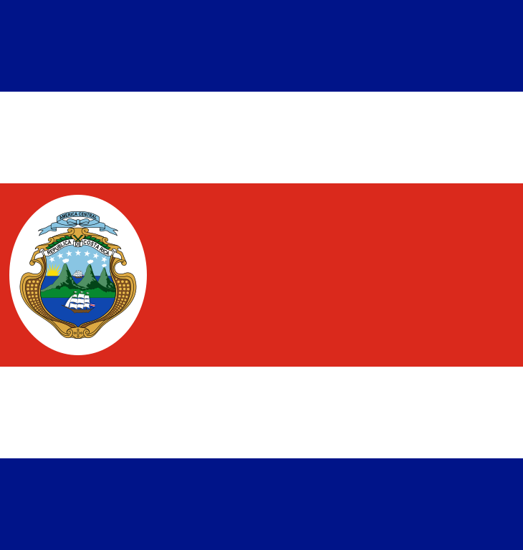
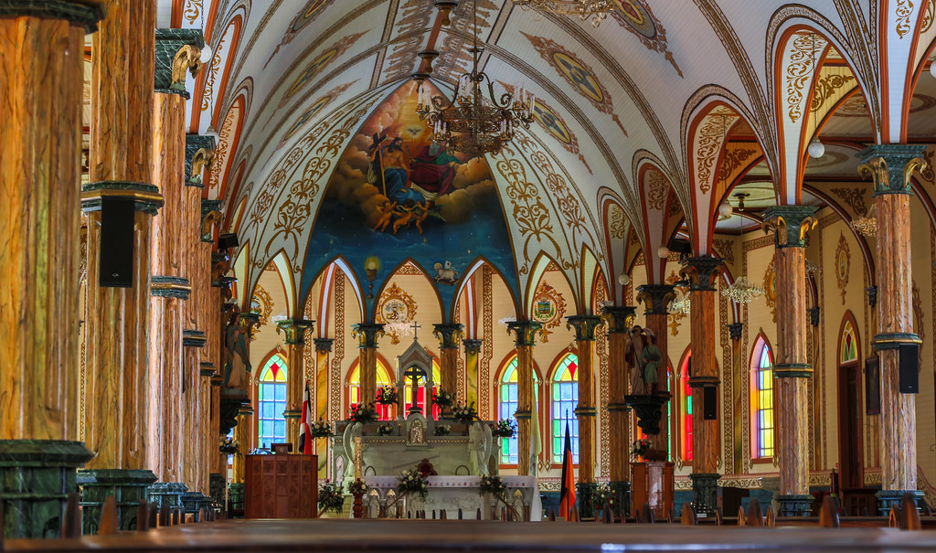
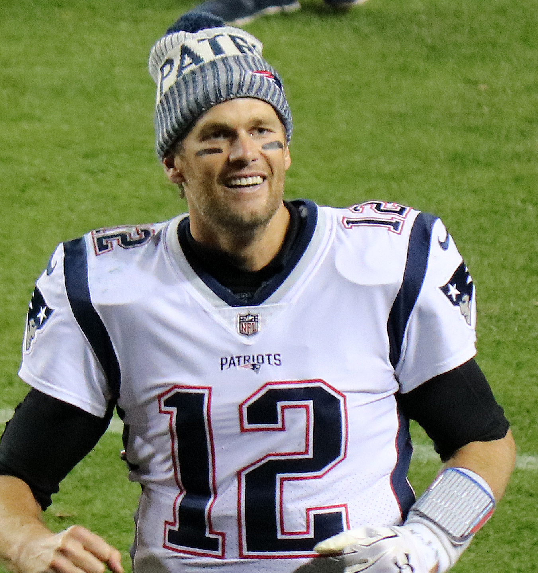
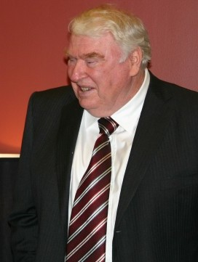
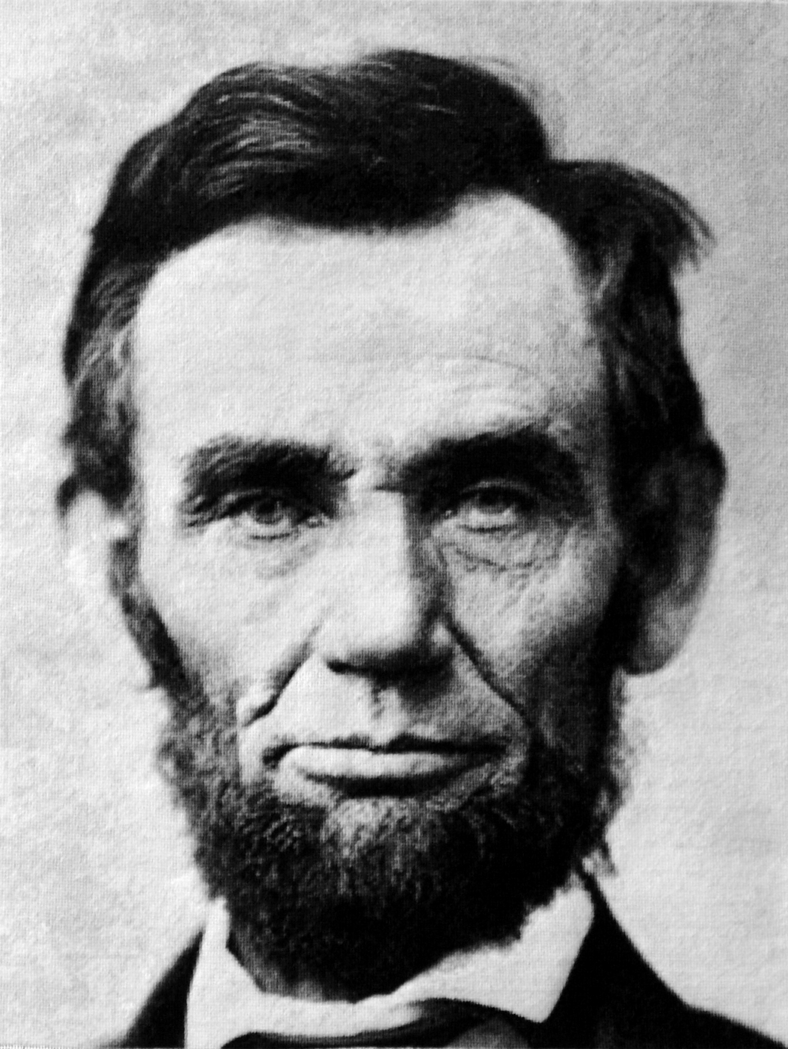
#costa rica
Costa rica tourism department
This Photo by Unknown Author is licensed under CC BY-SA
This Photo by Unknown Author is licensed under CC BY
Tom brady
I heard that 90% of Costa Rica was roman catholic faith
This Photo by Unknown Author is licensed under CC BY-SA
John madden
The church in Costa Rica horned there saints in church.
This Photo by Unknown Author is licensed under CC BY-SA
Abraham lincon
I heard that Costa Rica had the virgin of the angels
This Photo by Unknown Author is licensed under CC BY-SA

Slide 2
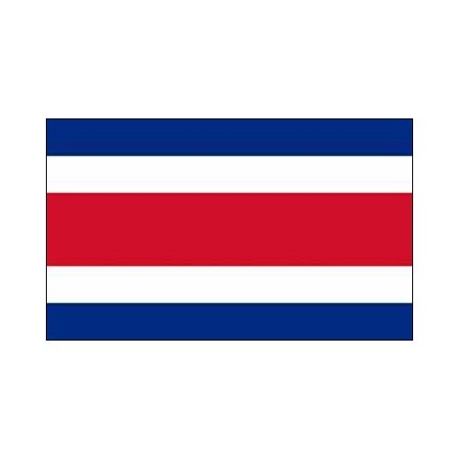
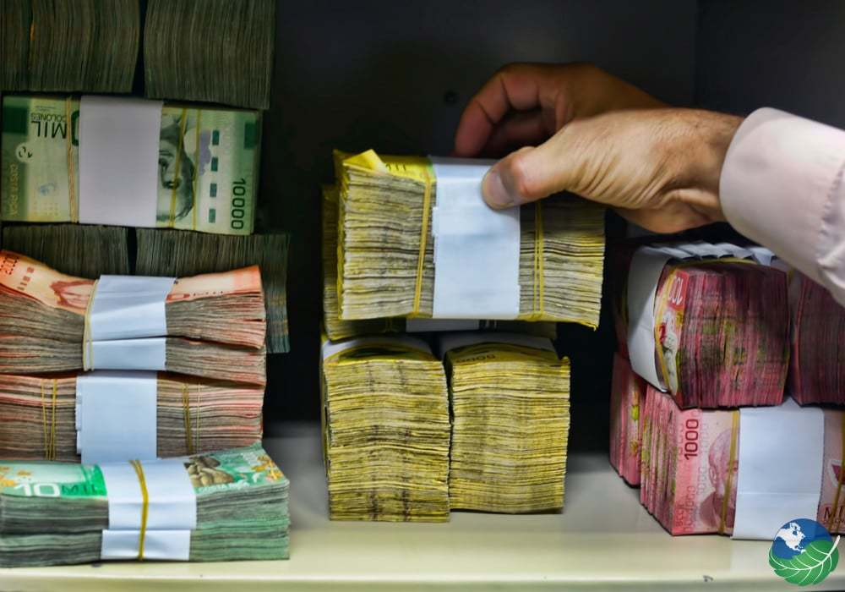
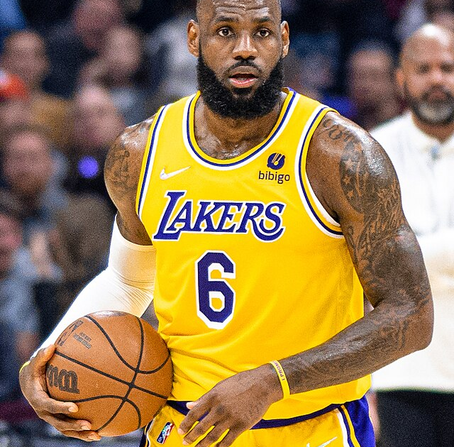
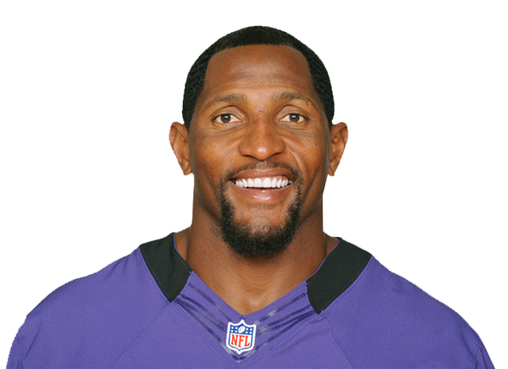
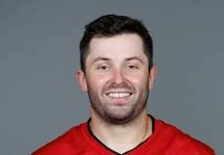
# lots of money
Costa Rica ecomy department
Lebron James
Costa Rica money is very colorful
Ray Lewis
Costa Rica use the colon for the currency for Costa Rica
Baker Mayfield
A 100 dollars in usd in costa Rica colin it would be 52,958.98

Slide 3
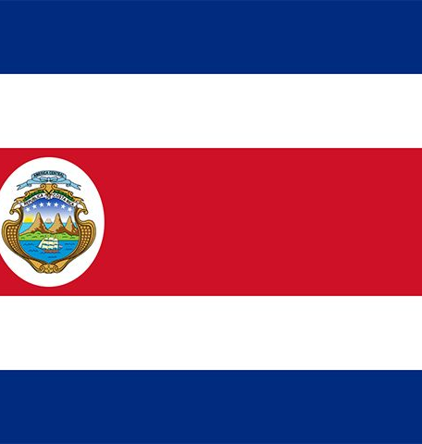

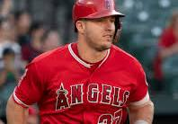
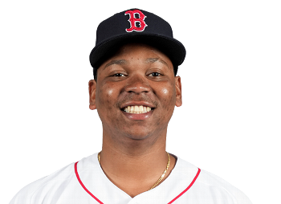
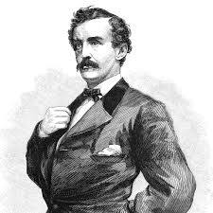
hh
Costa Rica politics department
Mike trout
There are a republic
Rafeal devers
there like America government
John wilks booth
there like Americas because there was women you got eleted to go for president

Slide 4
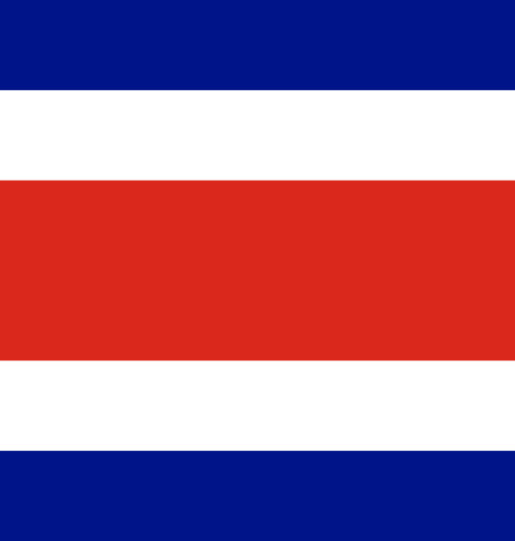
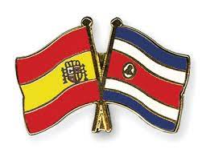
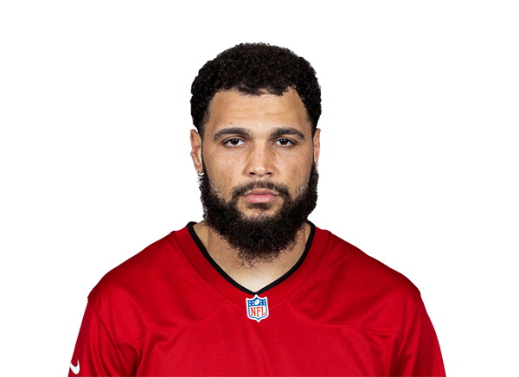
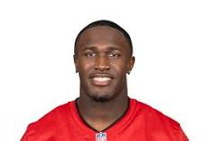
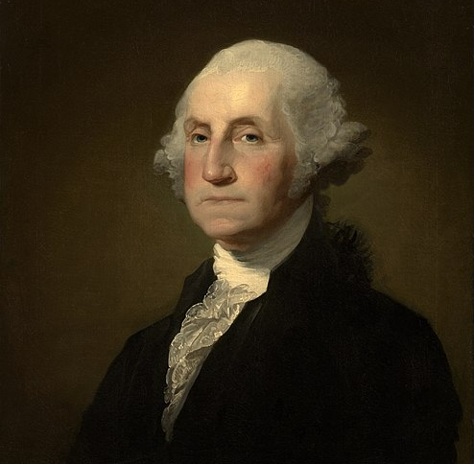
#my Spanish speaking people
Costa Rica laungage deparment
Mike evens
Did you know that Costa Rica and Spain have the same language
Devin white
Costa Rica has easy words to remember and talk Spanish
George Washington
Costa Rica speaks Three language's English, Spanish, and creole

Slide 5
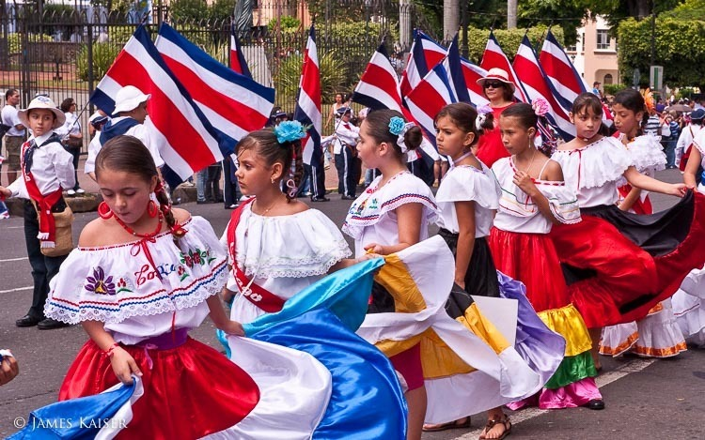
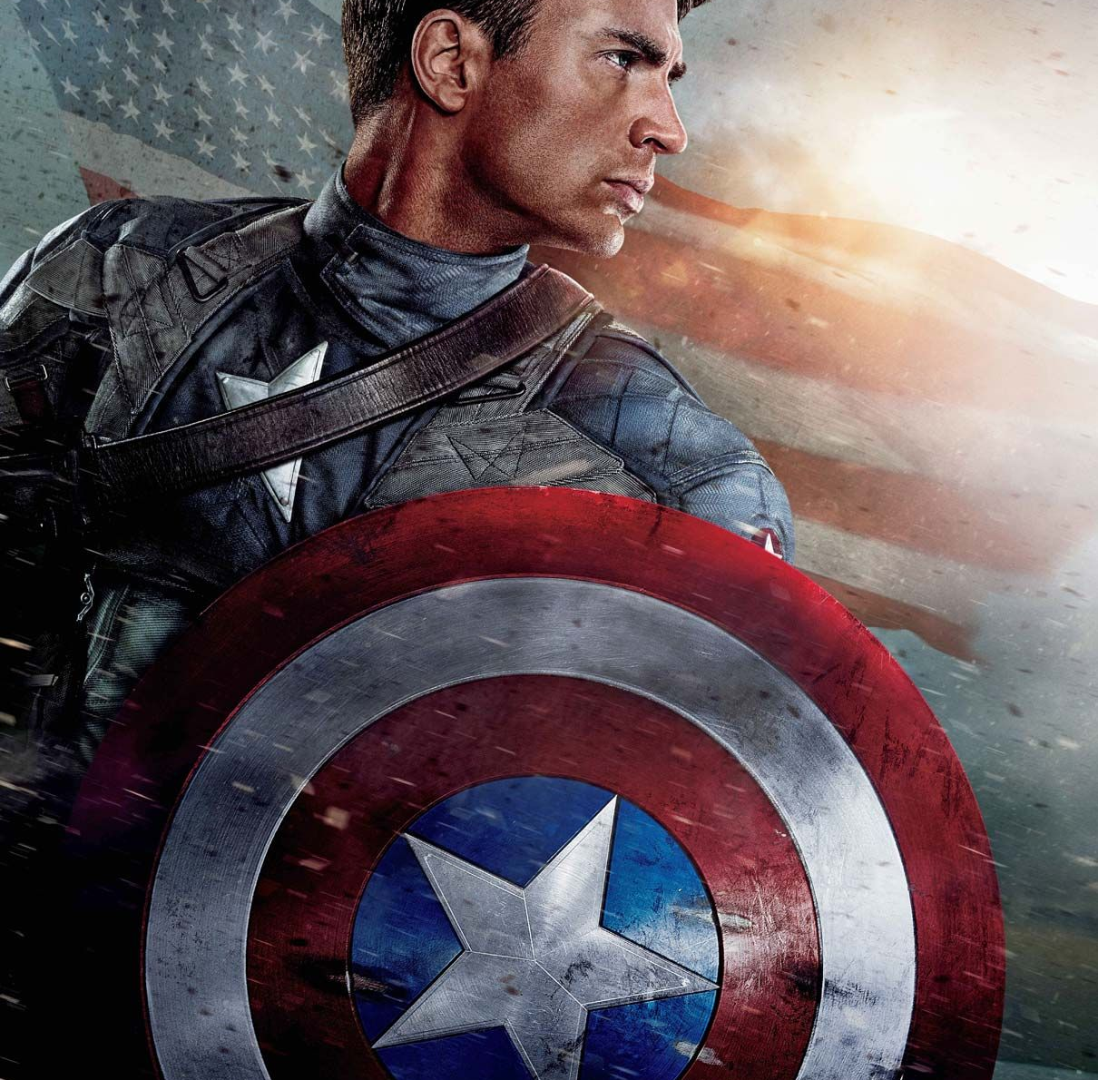
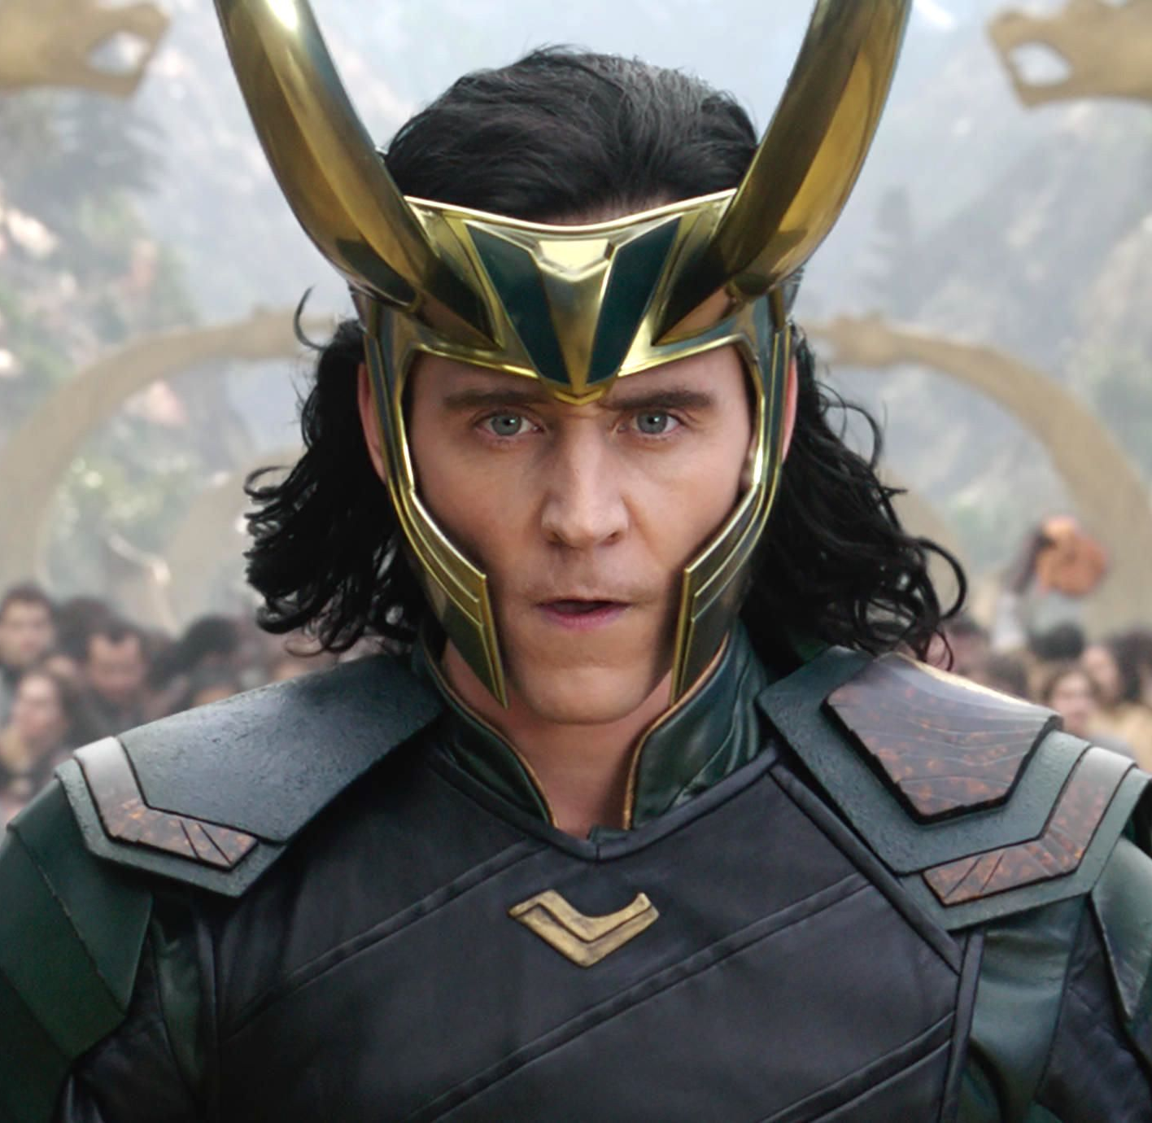
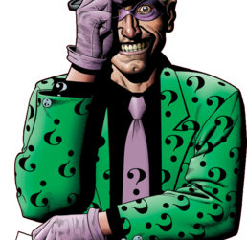
#culture of Costa Rica
Costa Rica customs and tradition deparment
Captain America
The women wear beautiful dresses
Loki
People come to to do tradition come out to the street for the traditions
Riddler
The Women dance on the street to people to see

Slide 6
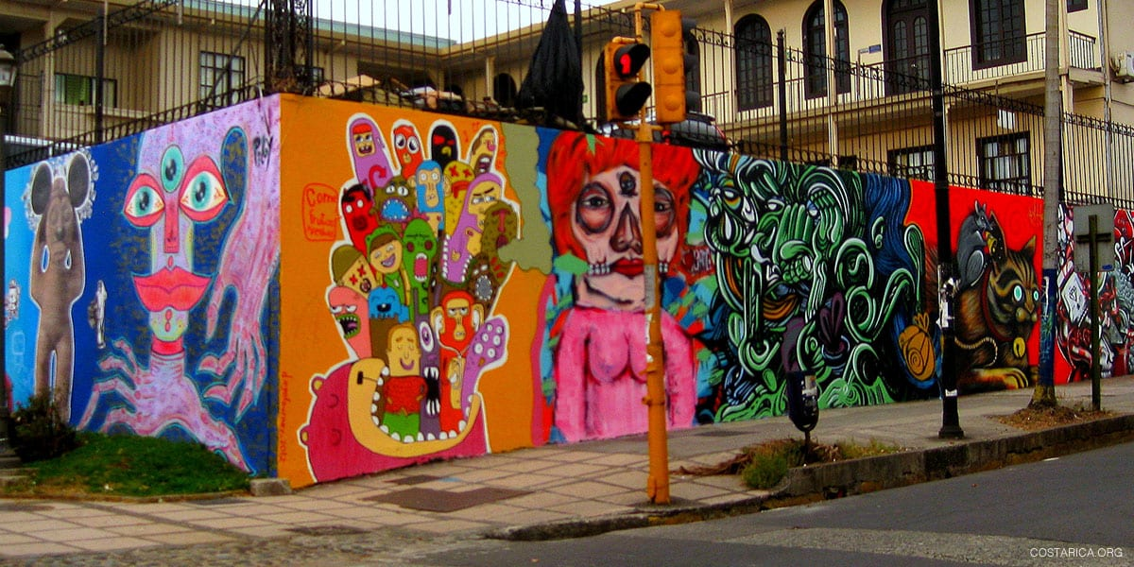
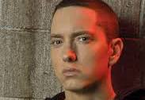
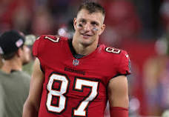
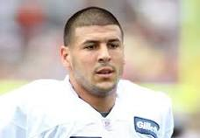
#buetiful art in Costa Rica
Costa Rica arts and liturcure
Eminem
Costa Rica art is so beautiful I wish I was there right now
Rob Gronkowski
There art is so creative with all the faces
Aron hernandez
This art is so mysterious and popping with color

Slide 7

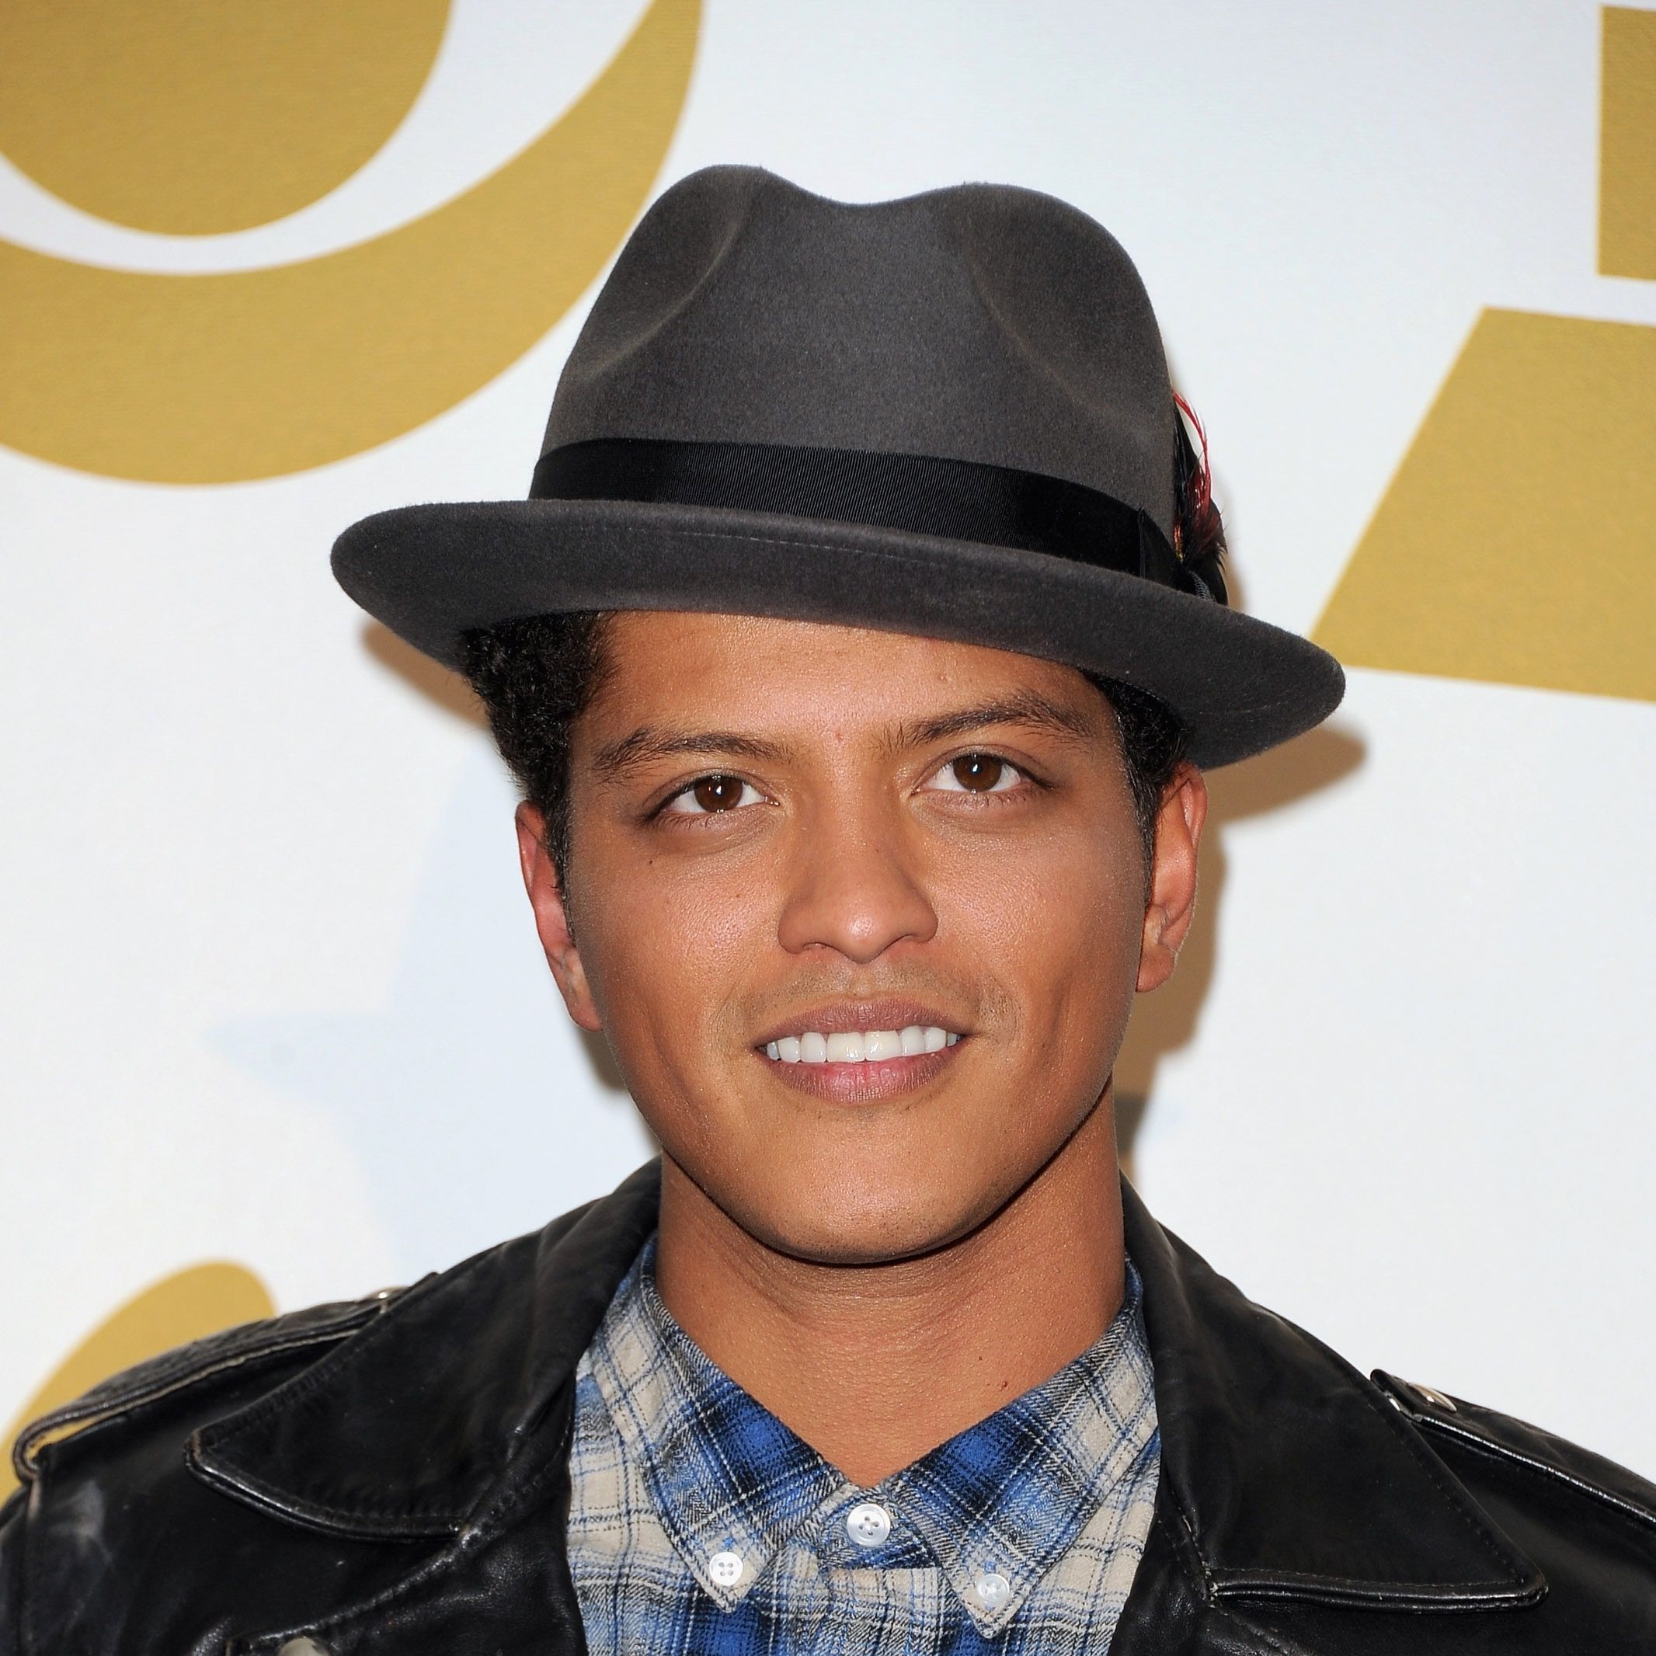
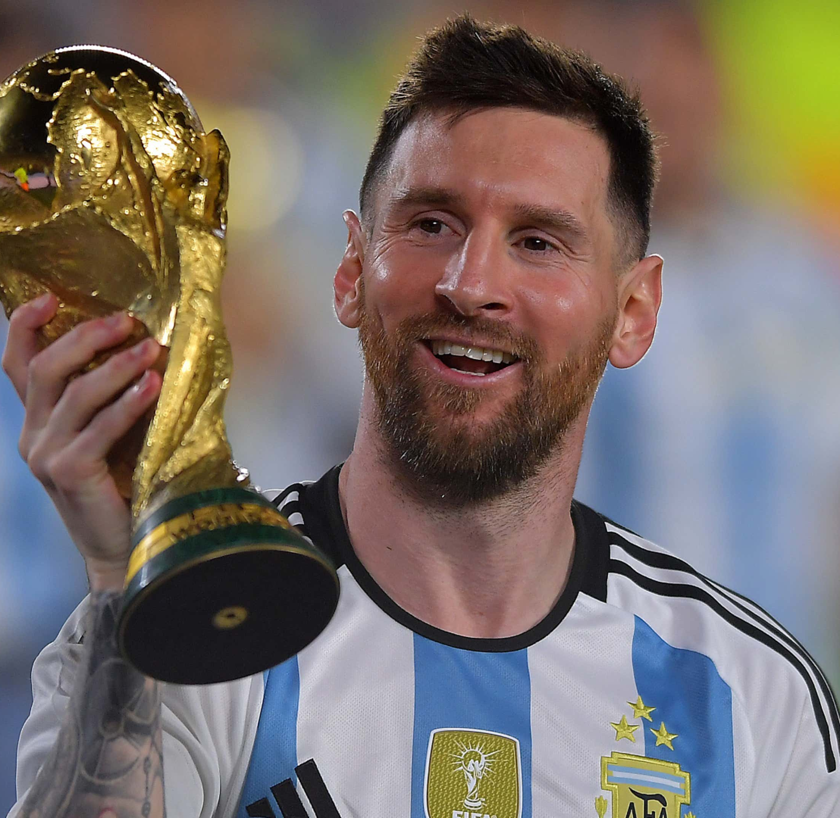

# national football costa rica
Costa Rica social organasation
Bruno Mars
The national team for Costa Rica has all the colors on the flag except the outer part
Lionel Messi
Did you know that the Costa Rica team was created In 1921
Chris Godwin
Did you know that the National team is name la sele

